Slide 1
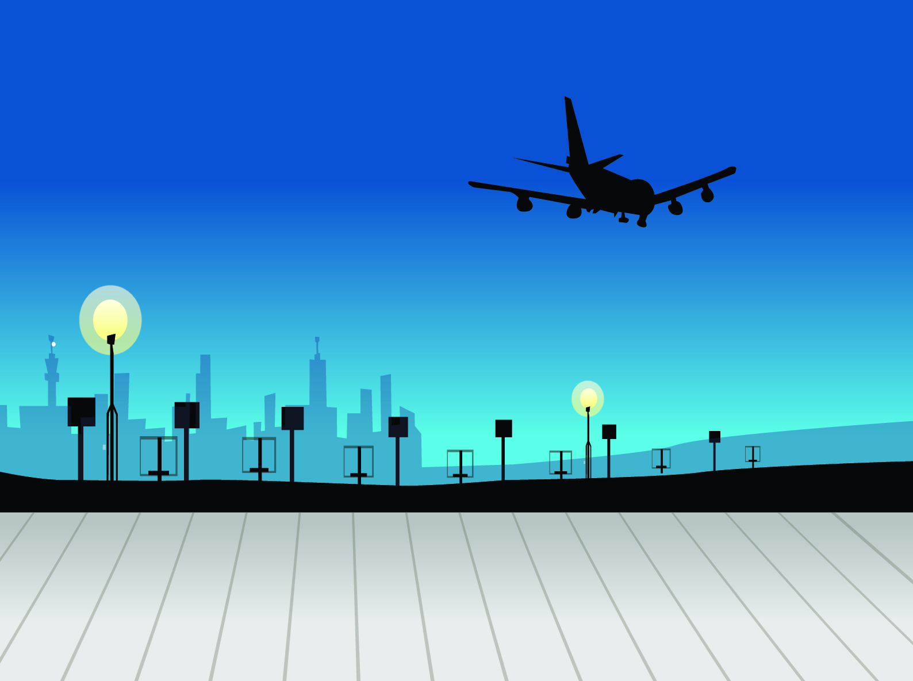


Montego Airline
Airline Safety
Presented by
Tushar Muley
November 20, 2021
Bellevue University DSC 640 | Professor C. Williams
Notes:
Welcome my name Tushar and we are going to talk about airline safety. Due to all the media hype, it has been on everyone’s mind lately. Hopefully after this presentation you’ll feel more comforting in knowing airlines are doing everything they can to make air travel safe for you and your family.
Let me give you some off the shelf numbers… Before I tell you a little story.
An airplanes flight can be separated in to 5 phases. Takeoffs and initial climb, cursing, destination and landing.

Slide 2



Airline Phases
Off the Shelf Numbers
Montego Airline
Takeoffs and Initial Climb
2% of the time | Cause 14% of all fatalities | 6% of the 14% are onboard
Cursing
57% of the time | Causes 11% of all fatalities
Landing and Destination
4% of the time | Causes 46% of all fatalities

Slide 3
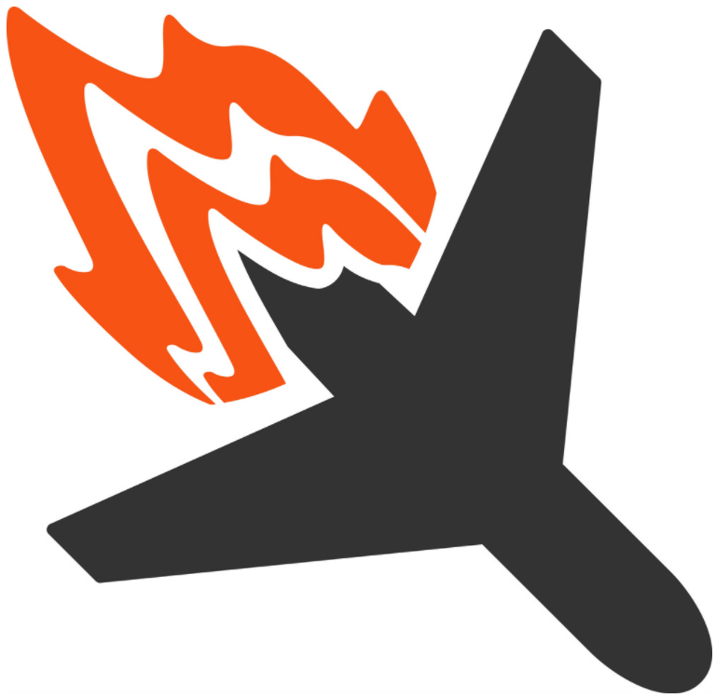
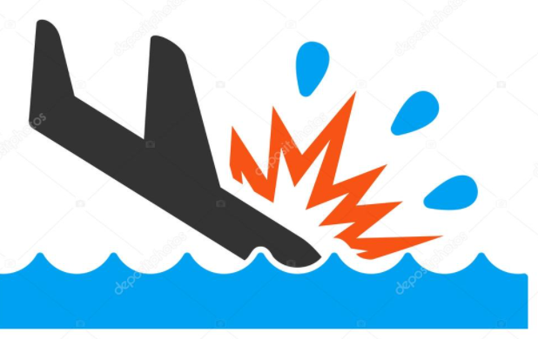
Three words!
Montego Airline
What are the three scariest words you can think of while on a plane?
Brace for impact.

Slide 4


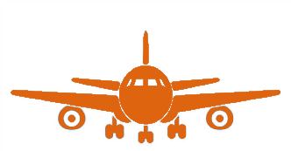
Fatalities by different Commercial Travel Modes
Comparing Commercial Travel
Montego Airline
287
36,096
268
Automobile fatalities are trending higher ever year
Train fatalities have risen in the last few years
Airlines fatalities are trending lower

Slide 5
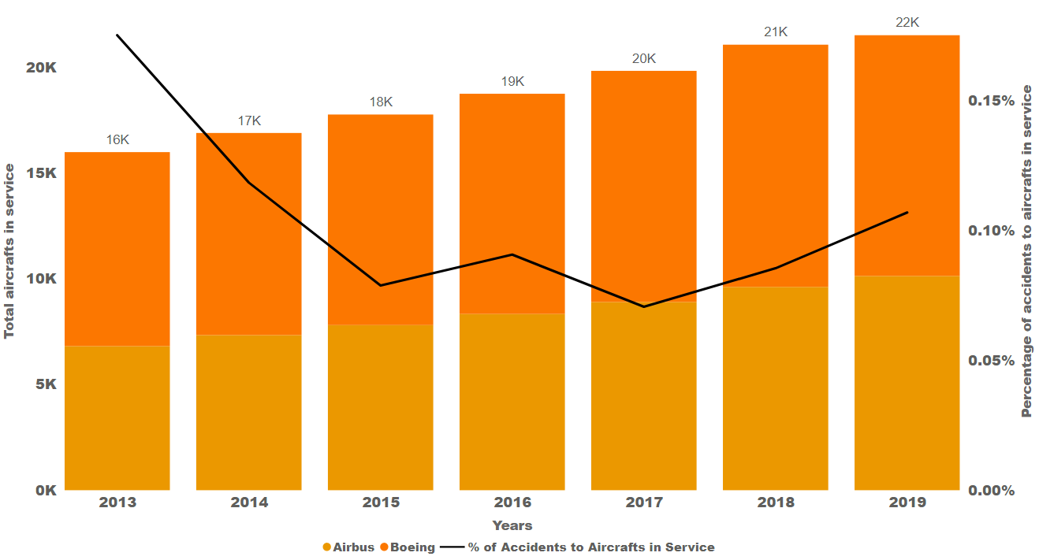
Airline Accidents by Manufacturer
Manufacturer Safety
Montego Airline
Accidents at there lowest rate of 0.12%
Over the last 6 years accidents are down while number of airlines is at the highest level in history

Slide 6
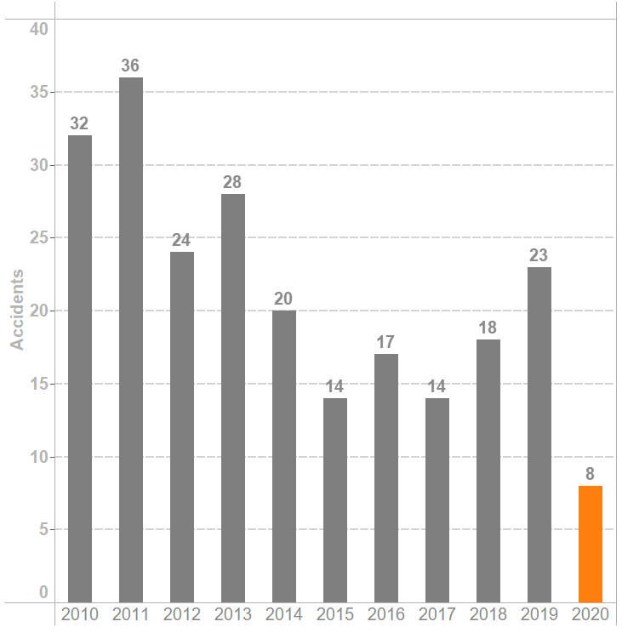

Number of Accidents in the Last 10 Years
Airline Related Accidents
Montego Airline
Historical low accidents
Overall trend has been reduction in accidents
Accident rate is 1.71 per million flights for 2020

Slide 7



Airline Safety Statics
By the Numbers Airline Travel
Montego Airline
4.5 Billion Passengers Safely Few in 2020
40.3 Million Flights Safely Flown in 2020
Accident rate down to 1.71 per million flights
1 in 18.56 Million the odds of being a accident in airplane
1 in 107 odds of being in a car accident

Slide 8
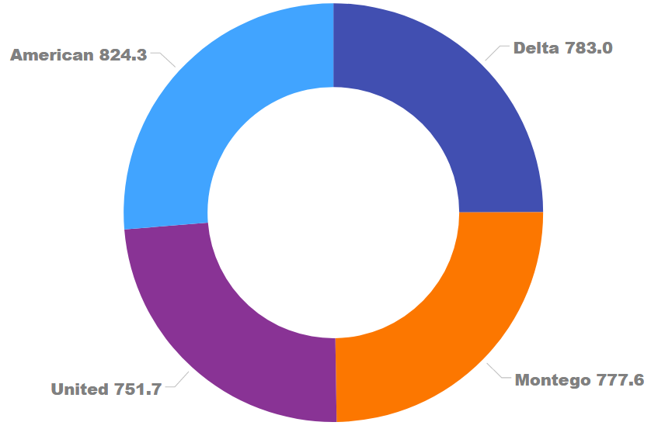
Top 4 Airlines Spent on Safety
Airline Spend on Safety
Montego Airline
3.13 Billion Total Spend on Safety
Third largest expenditure for airlines is on Safety
Airlines are expected to spend billions more on newer airlines to modernize their fleets

Slide 9

Final Comments
Montego Airline
Airline Travel still the safest way to travel

Slide 10

Montego Airline
Thank You.

